Slide 1
Aligning MRI anatomical scans with subjects' MEG head-shapes

Slide 2
This presentation is meant to complement Yuval's PPT
SAMtutorial
Which can be downloaded from the following location:
https://github.com/yuval-harpaz/SAM_BIU/tree/master/docs
Yuval's tutorial addresses the case where individual subjects do not have anatomical MRI scans, here we address the case that they do.

Slide 3
Notation
Some commands can be performed directly from Matlab, and some only from a linux terminal.
In this presentation, commands run from Matlab will be in green font; commands run from a linux terminal will be in red font.

Slide 4
  First, please read and execute the instructions in slides 1-9 in Yuval's SAMtutorial

Slide 5
Converting the MRI's DICOM files to an AFNI format
Change MATLAB's current directory to the subject's folder containing his MRI anatomy files (DICOM images. '.dcm' suffix)
See next slide for example of how such a folder should look like

Slide 6
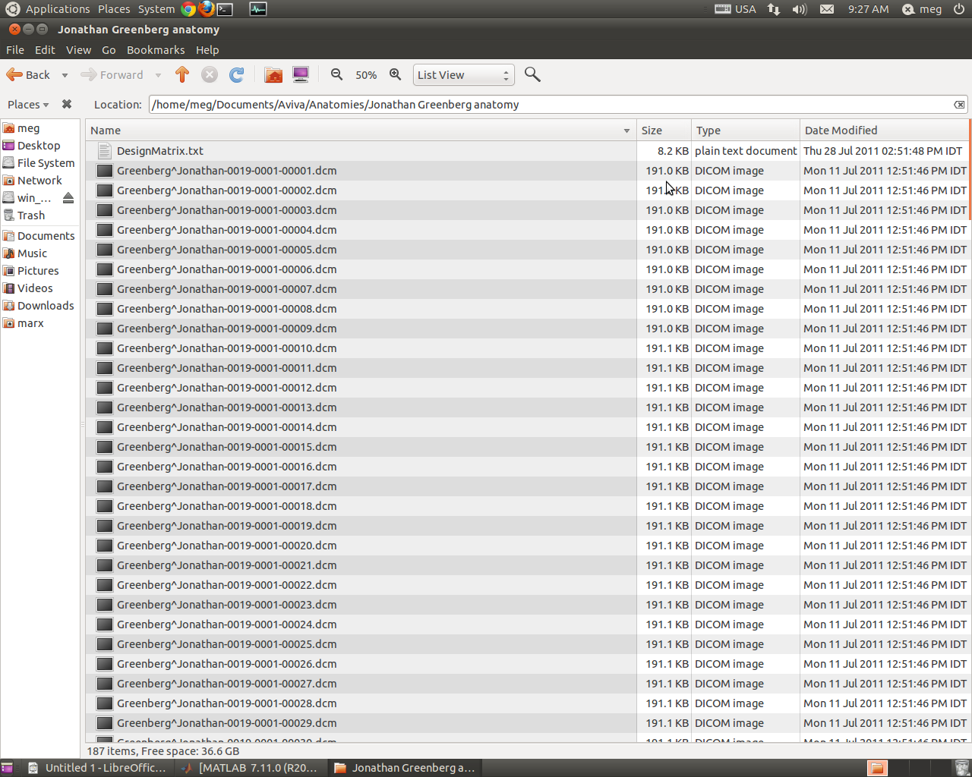
The MRI files look like this...

Slide 7
- Type ”to3d prefix*”
(all the subject's DICOM files will have the same filesPrefix, the * sign tells matlab to take all the files beginning with 'prefix'. For example: for subject Jonathan Greenberg (in previous slide), the files names are of the sort: Greenberg^Jonathan-0019-0001-00002.dcm. So our command could be to3d Green* )
- Name output file with '.anat' suffix – see next slide

Slide 9
Marking fiducial points
We now open a terminal window and CD to the directory holding the HS+orig files.
In the same folder, we also need a .tag file, on which we will write the spacial locations of the fiducial points. Such a file can be found at the following location: https://github.com/yuval-harpaz/SAM_BIU/tree/master/docs
The file is named: MNI305.tag. Rename it sub#.tag

Slide 10
Now we type afni in the terminal window (afni will now open)
Choose 'underlay' as anat file
Press: 'Define data mode' => 'plugin' => 'edit tagset' => 'datase't => 'anat'
Write in 'tag file': sub#.tag, and press 'read' button
See picture in next slide...

Slide 11
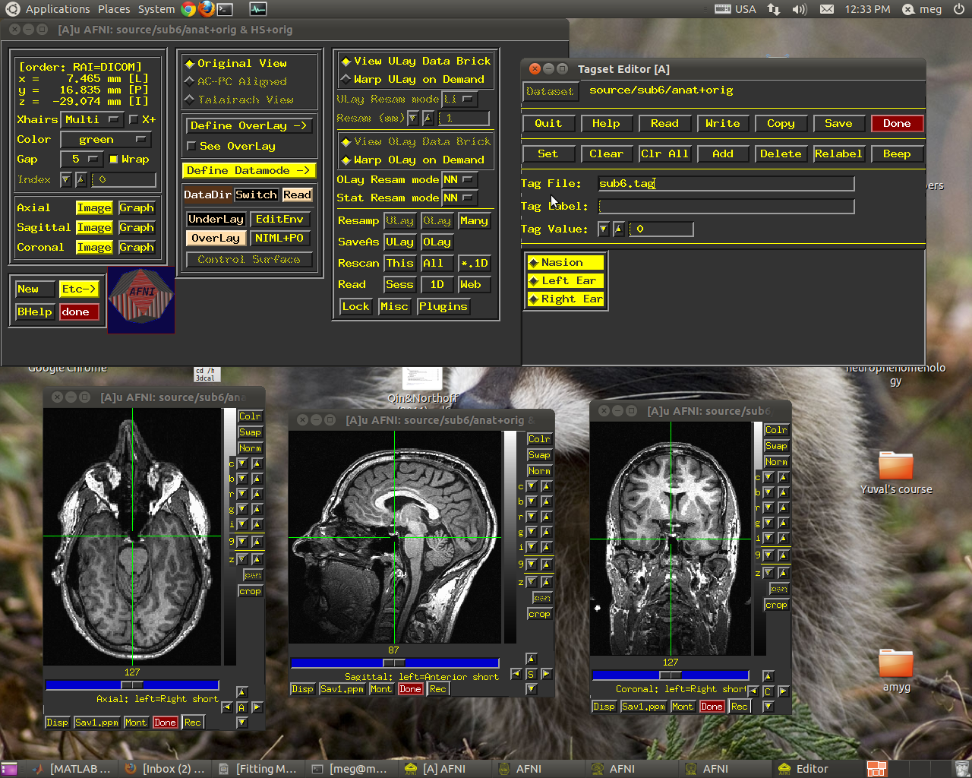

Slide 12
Now we manually find and mark the nasion and left and right ear fiducials
** This part is tricky!!! Get help when doing for the first time
First press on the fiducial point you want to find (located at the bottom of the tagset editor)
Then locate it
Then press 'set'
Repeat for all three fiducial points
** When locating the ear fiducials, don't forget that the directions are crossed (right=left)

Slide 13
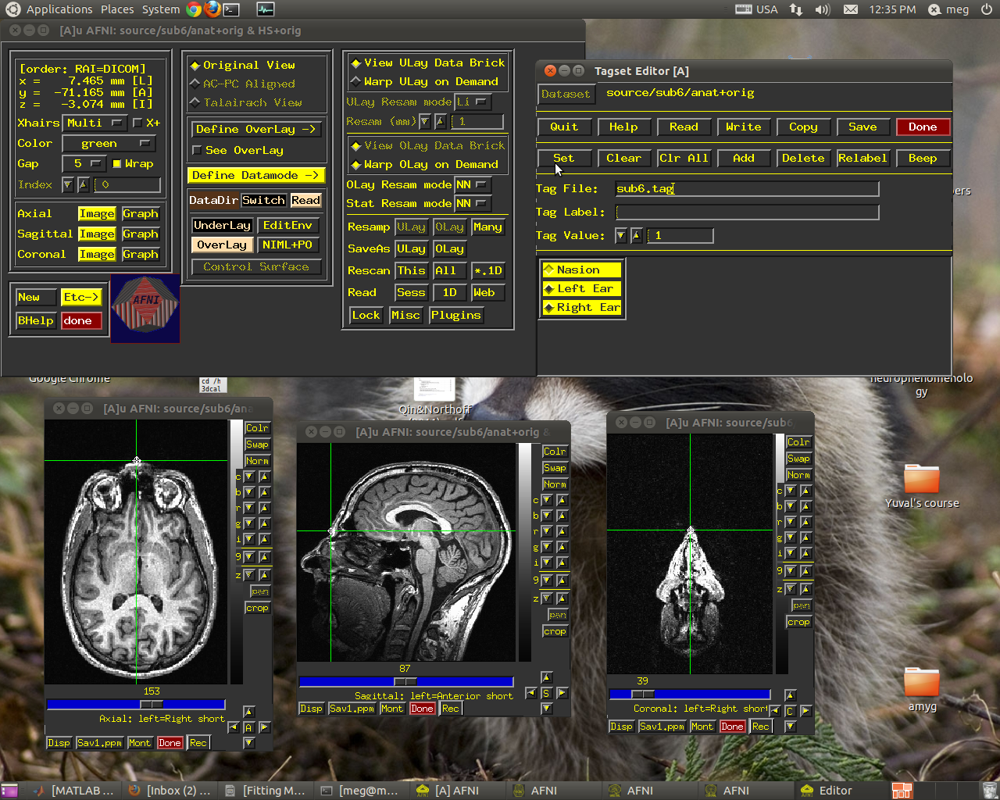
Here we see the nasion

Slide 14
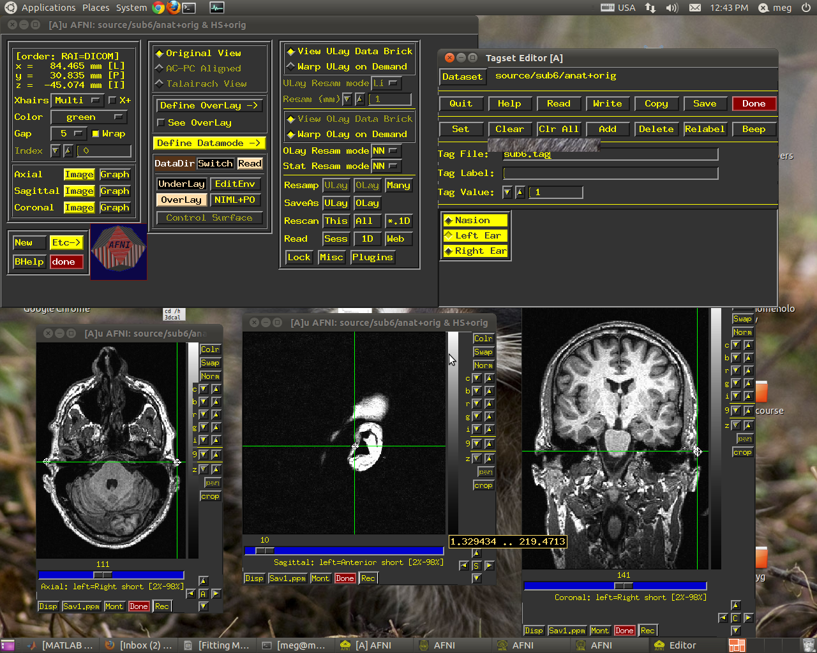
And here we see the left ear

Slide 15
When finished...
Press 'write' and the coordinates will be written into the sub#.tag file
Then press 'save' and the info will be added into the anat file
Then press 'done' in tagset editor and then in afni

Slide 16
3dTagalign
From your MATLAB current folder (with the .anat files) run the command:
!/home/megadmin/abin/3dTagalign -master /home/meg/brainhull/master+orig -prefix ./ortho anat+orig
This will align the fiducial points you just marked on the MRI with the fiducial points marked doing digitization.
The function's output are ortho+orig HEAD and BRIK files – these will be later used for nudgnig.

Slide 17
Now we transform the subject's headshape to an Afni format
Move the output of to3d (.anat file) to your data folder (as a reminder, make sure you have there your 'config', 'HS', and data files), and make sure it's your current directory
Run hs2afni(). The output will be HS+orig BRIK and HEAD files.
Great!!! Now we are all ready for nudging

Slide 18
Now you can continue with the nudging procedure, to make sure the head shape fits perfectly.
Yuval's SAMtutorial PPT explains how to do it – starting from slide # 12
You then happily go on with Yuval's SAMtutorial...
GOOD LUCK and may the SAM be with you : )

